Slide 1
STABLEMOE: Stable Routing Strategy for Mixture of Experts
ACL'22

Slide 2
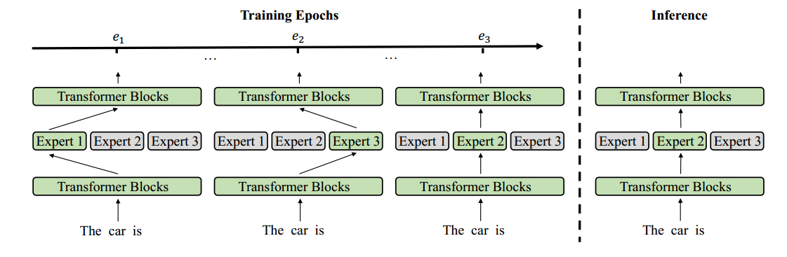
问题：
现有的MoE方法存在路由波动问题，即相同输入的目标，专家可能随着训练而变化，但在推理过程中只会为输入激活一个专家。路由波动往往会损害样本效率，因为相同的输入更新不同的专家，但最终只使用一个。

Slide 3
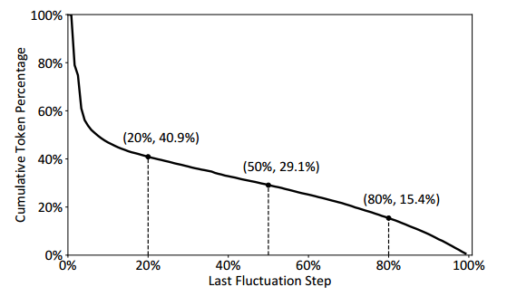
For an input token, we define the last fluctuation step as the last step where its target expert is different from the final step.
15.4% tokens even change the target expert after 80% of all training steps, which is nearing the training ending
STABLEMOE：
在第一个训练阶段，学习路由策略，并将其提炼成一个与骨干模型解耦的轻量级路由器。
在第二个训练阶段，利用经过提炼的路由来确定令牌到专家的分配，获得稳定的路由策略。

Slide 4
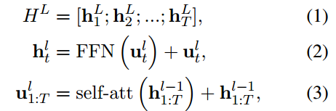

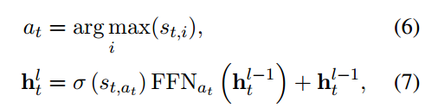
transformer
transformer
MoE
transformer
通过将由一组ffn组成的MoE层插入到两个相邻的Transformer块中来实现Transformer的MoE

Slide 5
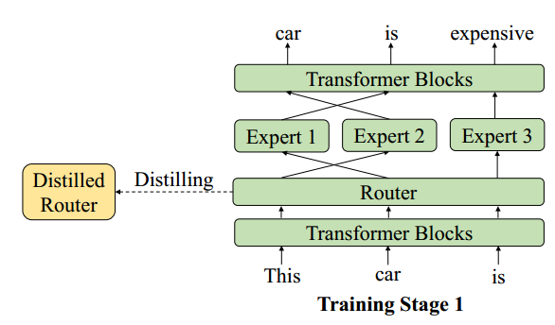
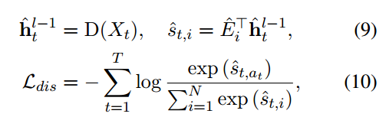
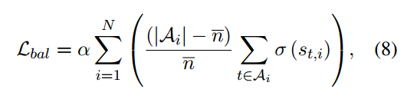

Training Stage 1: Learn Routing Strategy
增加额外参数：D，

Slide 6
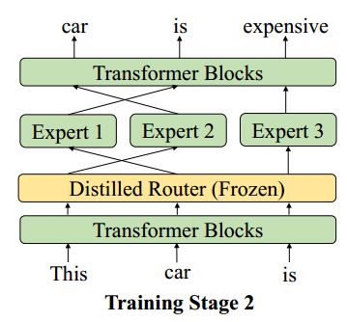
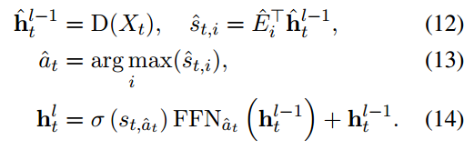
Training Stage 2: Learn with Stable Routing Strategy

Slide 7
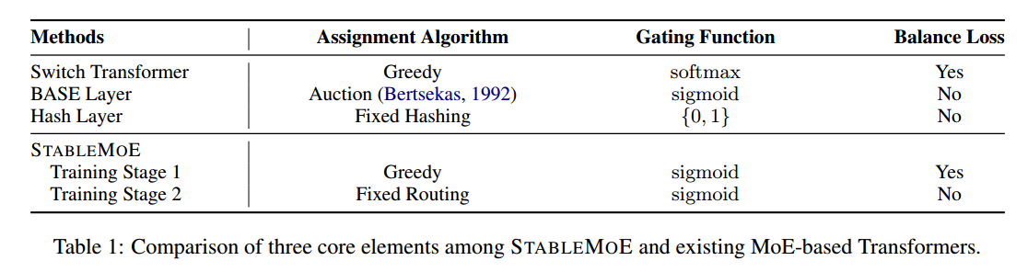
token-level fixed routing strategies have good stability.
Soft gating mechanisms urge models to learn a more cohesive token-to-expert assignment.
STABLEMOE has a stable, cohesive, and balanced routing strategy, while the other three MoE methods
cannot meet them all simultaneously.

Slide 8
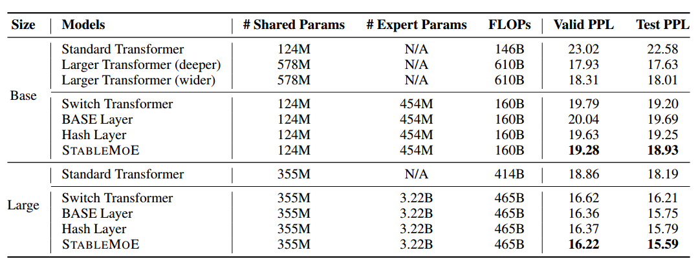
Under the base setting, STABLEMOE outperforms existing MoE methods on both the validation and the test sets by 0.3-0.8 perplexity.
STABLEMOE achieves about 3.7 lower perplexity than the standard Transformer, and about 1.3 higher perplexity than the deeper larger model.

Slide 9
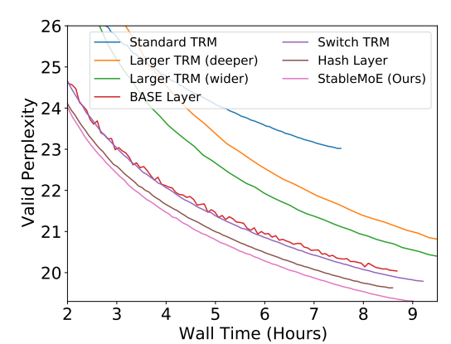
虽然较大的密集模型最终获得了较好的验证困惑度，但其训练速度相当慢。在收敛速度方面，基于MoE的模型通常超过密集模型。其中，STABLEMOE收敛速度最快。

Slide 10
